Slide 1
Coursera Capstone Project Famous Food Places In NEW Delhi By:-Megha Dua

Slide 2
Business Problem
Delhi is composed of number of food places which attracts foodies from the world. There are many venues (like cafes, restaurants, etc.) which can be explored and attracts foodies from the world.
This project involves data from both the Foursquare API and the Zomato API to fetch complete information of various places.
A map of the venues will be plotted to highlight their location, and information about these places.
Such plots assimilate plentiful data as their shaded portraits and area on the guide.

Slide 3
Data
Data Required
List of Localities and cities in Delhi
Latitude and Longitude coordinates of the Locality
Restaurant Data, related to different cuisines
Source of Data
Wikipedia page for Locality and Aggregate ratings of the Cuisines
Geocoder package for Latitude and Longitude Coordinates
Foursquare API for Restaurant data

Slide 4
Methodology
Web Scraping Wikipedia page for Localities list
Get latitude and Longitude Coordinates using Geocoder
Use foursquare API to get restaurant data
Group data by locality and taking the mean of the frequency of occurrence of each Cuisine category
Filter restaurant by different Cuisines
Perform Clustering of the data by using K-Means Clustering
Visualize the clusters in a map using Folium

Slide 5
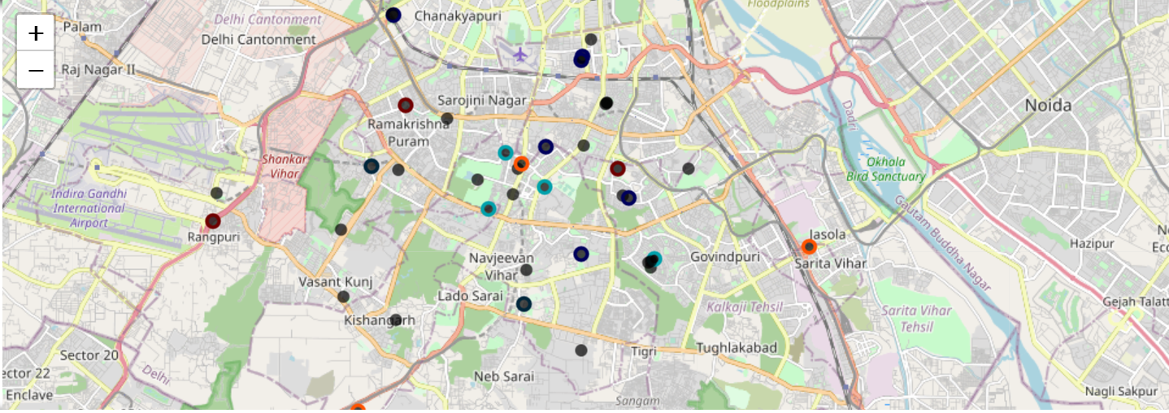
Results
Categories the Locality into Clusters based on the Aggregate ratings of the Cuisines

Slide 6
Discussion
Most of the Restaurant are concentrated in the central area of the city.
Highest number in Cluster 2 is of American fast food and moderate number in Cluster 0 is of Italian Cuisine.
Cluster 1 has very low number which is Korean Cuisine.

Slide 7
THANK YOu

